Slide 1
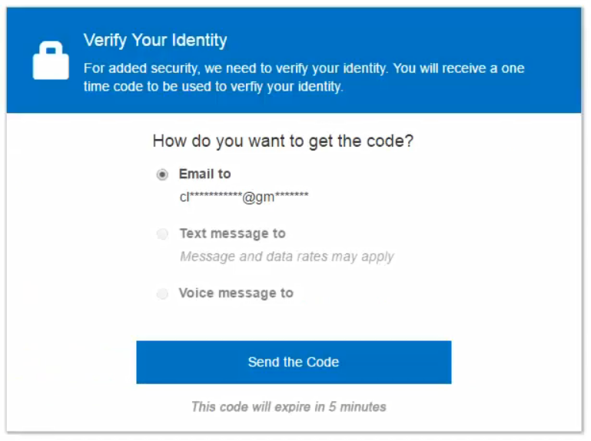
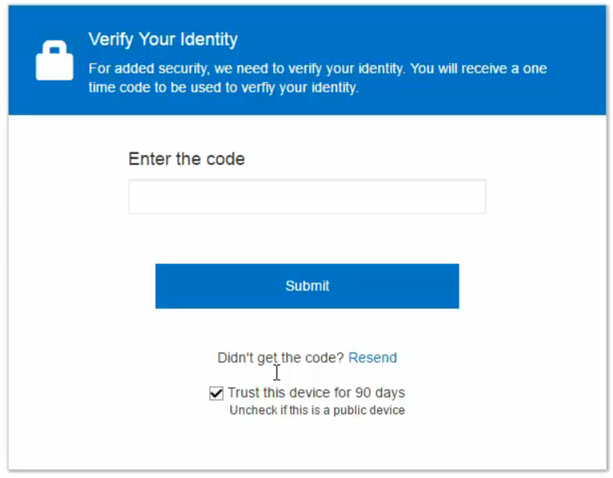
Logging in to CCH Axcess Portal/Client Axcess
Logging in with 2-step Verification
To verify your identity and protect your account, you must provide the correct one-time passcode.
Resetting your password
If you forget your password, don’t worry! You can easily reset your own password following the steps below:
On the Account Login page, click Forgot your password?.
Enter the email address you use as your Portal login ID.
Enter the case-sensitive characters in the Secure Code box.
Click Next.
Choose how to receive the one-time passcode:
  Email. The code will be sent to the email address associated with your user login.
  Text message to. The code will be sent via SMS text message to the phone number you select. You can select this option only if you have previously set up at least one telephone number in your user profile.
  Voice message to. The system will call the phone number you select; simply follow the voice prompts.
More information: https://support.cch.com/kb/solution.aspx/sw26720
Select an option to receive the security code.
Enter the security code you just received. Then click Submit.
If you are logging in from a trusted device, select Trust this device for 90 days if you want Portal to remember your device.

